Slide 1
Universe Design Tool
Milind Parab

Slide 2
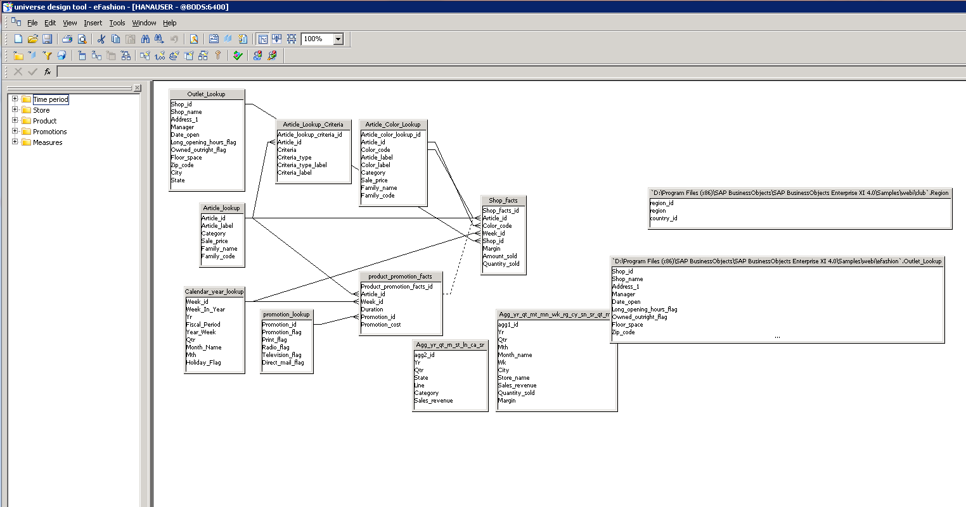
Sample UDT.

Slide 3
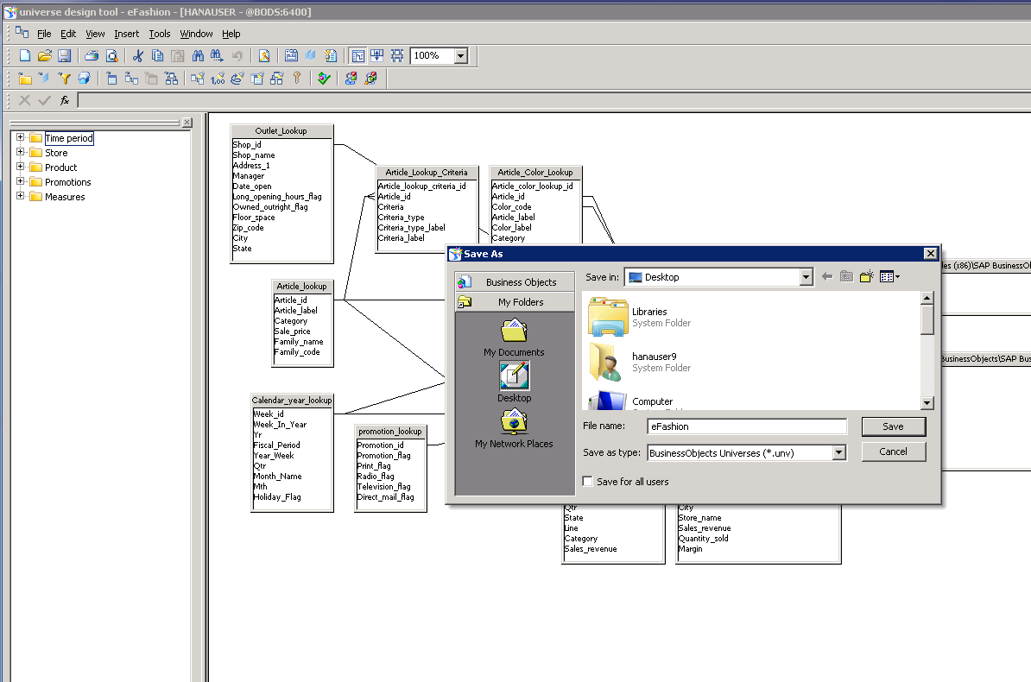
Cont.

